Slide 2
How do hot air balloons work?

Slide 3
Intro to Matter

Slide 4
Matter
Matter- anything with mass and volume
Mass- how much matter (stuff) is in an object

Slide 6
Study Jams Video
http://studyjams.scholastic.com/studyjams/jams/science/matter/properties-of-matter.htm

Slide 7
Mass vs. Weight
Weight- measure of gravitational force
Objects with greater mass have a greater gravitational force so they weigh more
Weight can change depending on location
Mass stays the same
Mass vs. Weight Gizmo

Slide 8
Volume
Volume- how much space something takes up
Regular solids- use math formulas (example- L x W x H)
Liquids- use graduated cylinder
Gas- volume of the container

Slide 9
BrainPop video
https://www.brainpop.com/science/matterandchemistry/measuringmatter/

Slide 10
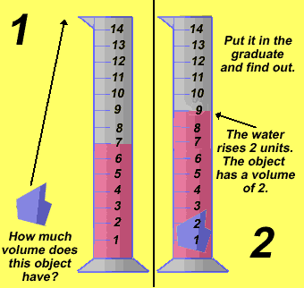
Irregular solids- use water displacement
Sketch this!

Slide 11
Density
How much mass is in a specific space
How heavy something is compared to its size
Density of a substance is the same no matter how much of the substance you have

Slide 12
