Slide 1
WELCOME TO 7TH GRADE SCIENCE
Coach Zills

Slide 2
WSMS
Virtual Expectations

Slide 3
W- Work Hard
Complete and submit all assignments on time
Login on time daily or assigned meeting times
Work independently or in groups when assigned
Stay focused
Identify a suitable workspace to use

Slide 4
S- Show Respect
Listen actively
Be an active member of the virtual community
“Raise” your hand to ask/answer questions
Get permission to walk away (ex: restroom break)
Mute your microphone until it is your turn to speak
Avoid multitasking during class
Stay focused

Slide 5
M- Maintain Control
Identify a suitable workplace that is clutter free
Posting negative or inappropriate comments in chats or other areas is not allowed
Mute your microphone until it is your time to speak
Stay logged in the entire class period
Stay focused

Slide 6
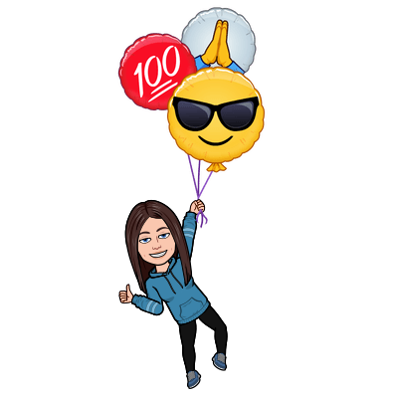
S- Strive for Excellence
Stay focused
High expectations for all students
100% implementation of the school-wide expectations in virtual classrooms

Slide 7
MATERIALS
Composition book/ notebook paper
Textbook
Highlighter (to use in your textbook)
Pens/pencils
SCS device/headphones

Slide 8
“Who am I?” Scavenger Hunt
You will have 2 minutes to find 3 items that represent you or something about you.
If you would like to share with the class, “raise” your hand and wait to be called on.
Make sure your items are appropriate! ☺

Slide 9
Questions?

